Slide 1
MACHINE LEARNING MINI-PROJECT
Spam Review Detection Using the Linguistic and Spammer Behavioral Methods
-N. Hussain, H. Turab Mirza, I. Hussain, F. Iqbal and I. Memon, "Spam Review Detection Using the Linguistic and Spammer Behavioral Methods," in IEEE Access, vol. 8, pp. 53801-53816, 2020, doi: 10.1109/ACCESS.2020.2979226.
Team Members:
1.ANUKUL KUMAR (1806093)
2.ANKIT GOND (1806016)
3.RITESH SINGH (1806092)

Slide 2
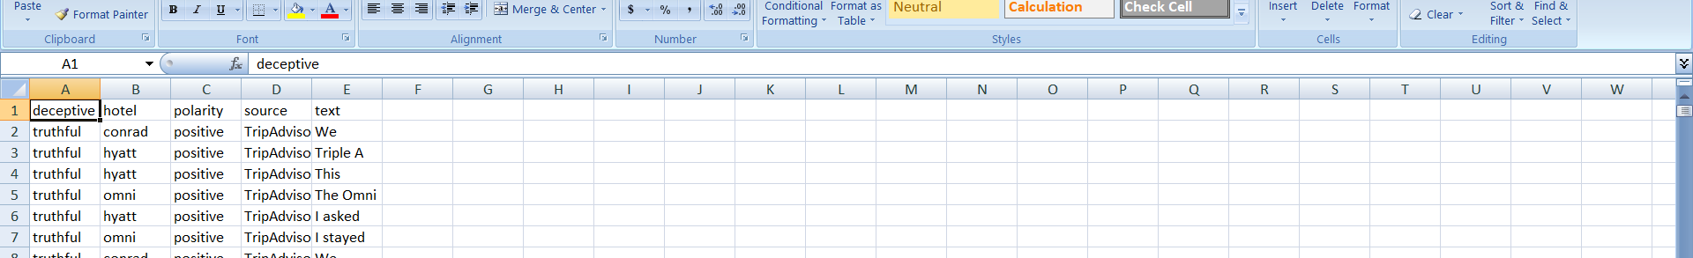
DATA SOURCE
For this project we used the spam review dataset which contains reviews which are both truthful and deceptive.
The dataset consists of hotel reviews of top 20 hotels in US.
Each row consists of five(5) columns.
Column 1(Deceptive ):-consists the characteristic of a particular review.
Either it is deceptive or truthful.
Column 2(Hotel name): holds the value of hotel for which the review has been given.
Column 3 (Polarity):holds the value of polarity of the review either positive or negative.
Column 4 (Source):holds the source from which the review has been collected.
Column 5 (text):holds the main review text.

Slide 3
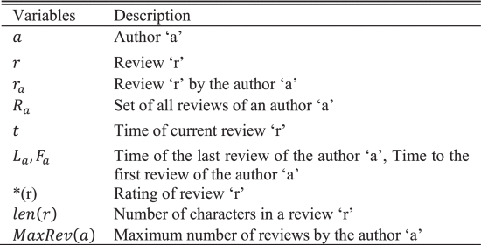
Spam Review Detection using Behavioral Method(SRD-BM)
Description of features used for SRD-BM
SRD-BM employs a behavioral way to recognize spam review and focussed on the reviewer more than the review itself.
It uses 13 key features which identify a suspicious behavior.

Slide 4
List of features used :
Content Similarity (CS) - F1
Maximum Number of Reviews (MNR) - F2
Review Burstiness (RB) - F3
Activity Window (AW) - F4
Review Count (RC) - F5
The Ratio of Positive Reviews (PR) - F6
The Ratio of Negative Reviews (NR) - F7
The Ratio of First Reviews (FR) - F8
Review of a Single Product (RSP) - F9
Rating Deviation (RD) - F10
Review Length (RL) - F11
Extreme Rating (ER) - F12
The Ratio of Capital Letters (RCL) - F13

Slide 5
Spam Review Detection using Behavioral Method(SRD-BM)
Each of the features are normalized and a mean score is calculated for each review.
Then one by one each feature is dropped keeping all other features intact, thus calculating the weight of each feature.
Then the spam score is calculated for each review again using the new weights.
If the spam score is greater than the threshold score,
the review is labelled spam otherwise not spam.

Slide 6
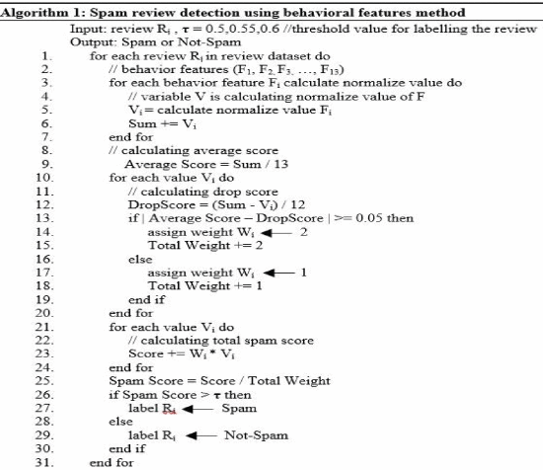
Algorithm for SD_BM

Slide 7
Spam Review Detection Using Linguistic Method (SRD-LM)
Dataset: The labeled data from SRD-BM is used as dataset for SRD-LM.
Pre-Processing: Removing Stop words, Stemming words,
and tokenization.
N-gram technique is used to generate unigram, bi-gram and tri-gram tokens.

Slide 8
Spam Review Detection Using Linguistic Method (SRD-LM)
Transformation: TF-IDF is used to transform the tokens into numerical vector.TF-IDF value increases for a token with the number of occurrence. Provides weight to tokens.
Feature Selection: Feature selection technique is used to select most important features which appear in the review dataset. The proposed approach uses Information Gain (IG) for feature selection. Term frequency has been used to select the top 1%, 2%, 3% and 4% features, respectively.

Slide 9
Spam Review Detection Using Linguistic Method (SRD-LM)
Classification: Classification is done using the below four models.
Naïve Bayes(NB) Classifier
Logistic Regression(LR) Classifier
Support Vector Machine(SVM) Classifier
Random Forest(RF) Classifier

Slide 10
Results and Conclusion
The models when run on our dataset gives an accuracy as follows:
SVM-52%
Naïve Bayes-71%
RandomForest-75%
Logistic Regression-89%

